Slide 1
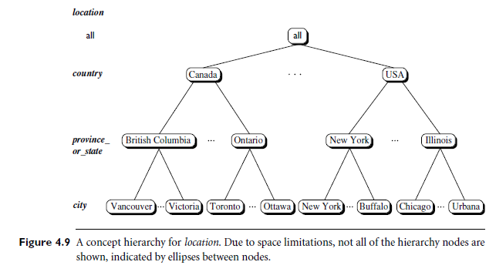
Concept Hierarchy
A concept hierarchy defines a sequence of mappings from a set of low-level concepts to higher-level, more general concepts.

Slide 2
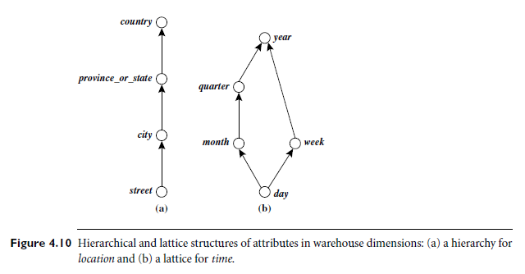

Slide 3
Hierarchical organization -more efficient and effective data analysis.
Ability to drill down to more specific levels of detail when needed.
Use - to organize and classify data in a way that makes it more understandable and easier to analyze.
Main idea behind –
the same data can have different levels of granularity or levels of detail
By organizing the data in a hierarchical fashion, it is easier to understand and perform analysis.
Notes:
This hierarchical organization of data allows for more efficient and effective data analysis, as well as the ability to drill down to more specific levels of detail when needed.
The concept of hierarchy is used to organize and classify data in a way that makes it more understandable and easier to analyze.
The main idea behind the concept of hierarchy is that the same data can have different levels of granularity or levels of detail and that by organizing the data in a hierarchical fashion, it is easier to understand and perform analysis.

Slide 4
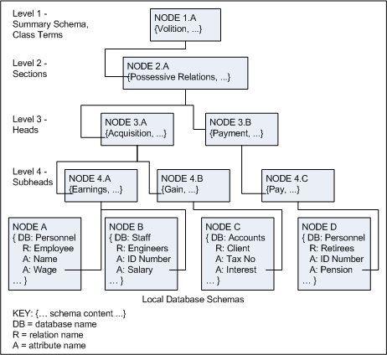
Types of Concept Hierarchies
Schema Hierarchy
Used to organize the schema of a database in a logical and meaningful way, grouping similar objects together.
Can be used to organize different types of data, such as tables, attributes, and relationships, in a logical and meaningful way.
Useful in data warehousing, where data from multiple sources needs to be integrated into a single database.

Slide 5
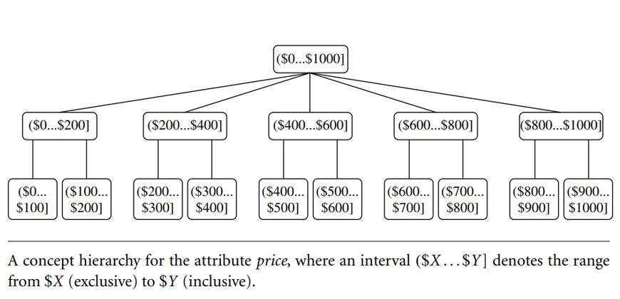
Types of Concept Hierarchies
Set-Grouping Hierarchy
Based on set theory
Each set in the hierarchy is defined in terms of its membership in other sets.
Can be used for data cleaning, data pre-processing and data integration.
Can be used to
identify and remove outliers, noise, or inconsistencies from the data.
to integrate data from multiple sources.

Slide 6
Types of Concept Hierarchies
Operation-Derived Hierarchy
Organize data by applying a series of operations or transformations to the data.
The operations are applied in a top-down fashion.
Each level of the hierarchy representing a more general or abstract view of the data than the level below it.
Typically used in data mining tasks such as clustering and dimensionality reduction.
The operations applied can be mathematical or statistical operations such as aggregation, normalization
Eg: email address: login name< department< university< Country
abc@cs.ktu.in

Slide 7
Types of Concept Hierarchies
Rule-based Hierarchy
Used to organize data by applying a set of rules or conditions to the data.
Useful in data mining tasks such as classification, decision-making, and data exploration.
It allows to the assignment of a class label or decision to each data point based on its characteristics
Identifies patterns and relationships between different attributes of the data.

Slide 10
Need of Concept Hierarchy in Data Mining
There are several reasons why a concept hierarchy is useful in data mining:
Improved Data Analysis
Improved Data Visualization and Exploration
Improved Algorithm Performance
Data Cleaning and Pre-processing
Domain Knowledge
Notes:
There are several reasons why a concept hierarchy is useful in data mining:
Improved Data Analysis: A concept hierarchy can help to organize and simplify data, making it more manageable and easier to analyze. By grouping similar concepts together, a concept hierarchy can help to identify patterns and trends in the data that would otherwise be difficult to spot. This can be particularly useful in uncovering hidden or unexpected insights that can inform business decisions or inform the development of new products or services.
Improved Data Visualization and Exploration: A concept hierarchy can help to improve data visualization and data exploration by organizing data into a tree-like structure, allowing users to easily navigate and understand large and complex data sets. This can be particularly useful in creating interactive dashboards and reports that allow users to easily drill down to more specific levels of detail when needed.
Improved Algorithm Performance: The use of a concept hierarchy can also help to improve the performance of data mining algorithms. By organizing data into a hierarchical structure, algorithms can more easily process and analyze the data, resulting in faster and more accurate results.
Data Cleaning and Pre-processing: A concept hierarchy can also be used in data cleaning and pre-processing, to identify and remove outliers and noise from the data.
Domain Knowledge: A concept hierarchy can also be used to represent the domain knowledge in a more structured way, which can help in a better understanding of the data and the problem domain.

Slide 11
Applications of Concept Hierarchy
There are several applications of concept hierarchy in data mining, some examples are:
Data Warehousing
Business Intelligence
Online Retail
Healthcare
Natural Language Processing
Fraud Detection
Notes:
Applications of Concept Hierarchy
There are several applications of concept hierarchy in data mining, some examples are:
Data Warehousing: Concept hierarchy can be used in data warehousing to organize data from multiple sources into a single, consistent and meaningful structure. This can help to improve the efficiency and effectiveness of data analysis and reporting.
Business Intelligence: Concept hierarchy can be used in business intelligence to organize and analyze data in a way that can inform business decisions. For example, it can be used to analyze customer data to identify patterns and trends that can inform the development of new products or services.
Online Retail: Concept hierarchy can be used in online retail to organize products into categories, subcategories and sub-subcategories, it can help customers to find the products they are looking for more quickly and easily.
Healthcare: Concept hierarchy can be used in healthcare to organize patient data, for example, to group patients by diagnosis or treatment plan, it can help to identify patterns and trends that can inform the development of new treatments or improve the effectiveness of existing treatments.
Natural Language Processing: Concept hierarchy can be used in natural language processing to organize and analyze text data, for example, to identify topics and themes in a text, it can help to extract useful information from unstructured data.
Fraud Detection: Concept hierarchy can be used in fraud detection to organize and analyze financial data, for example, to identify patterns and trends that can indicate fraudulent activity

Slide 12
OLAP Operations
OLAP ONLINE ANALYTICAL PROCESSING (OLAP) provides a user-friendly environment for Interactive data analysis.
In the multidimensional model, data are organized into multiple dimensions, and each dimension contains multiple levels of abstraction defined by concept hierarchies.

Slide 13
OLAP operations
ROLL-UP (aka DRILL UP):summarize data
ROLL DOWN or DRILL-DOWN : reverse of roll up
SLICING AND DICING : project and select
PIVOT (ROTATE): reorient the cube
Additional
Drill across
Drill through

Slide 14
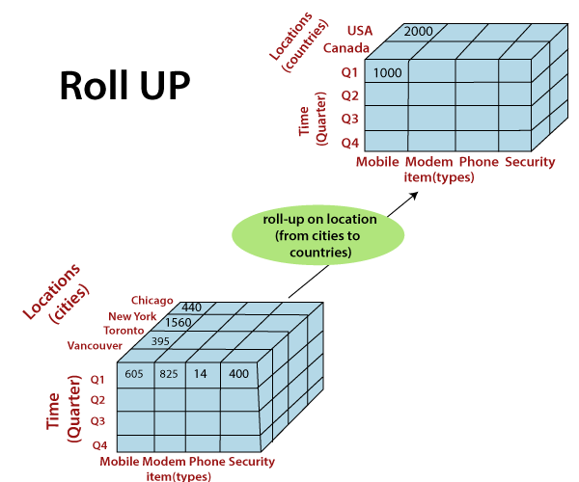
Roll Up/Drill Up/Aggregation
Performs aggregation on a data cube, either by climbing up a concept hierarchy for a dimension or by dimension reduction.
Notes:
The roll-up operation (also known as drill-up or aggregation operation) performs aggregation on a data cube, by climbing down concept hierarchies, i.e., dimension reduction. Roll-up is like zooming-out on the data cubes. Figure shows the result of roll-up operations performed on the dimension location. The hierarchy for the location is defined as the Order Street, city, province, or state, country. The roll-up operation aggregates the data by ascending the location hierarchy from the level of the city to the level of the country.
When a roll-up is performed by dimensions reduction, one or more dimensions are removed from the cube. For example, consider a sales data cube having two dimensions, location and time. Roll-up may be performed by removing, the time dimensions, appearing in an aggregation of the total sales by location, relatively than by location and by time.

Slide 15
Roll Down/Drill-down
Drill-down is the reverse of roll-up.
Drill-down is like zooming-in on the data cube.
It navigates from less detailed data to more detailed data.
Drill-down can be realized by either stepping down a concept hierarchy for a dimension or introducing additional dimensions.
Notes:
The drill-down operation (also called roll-down) is the reverse operation of roll-up. Drill-down is like zooming-in on the data cube. It navigates from less detailed record to more detailed data. Drill-down can be performed by either stepping down a concept hierarchy for a dimension or adding additional dimensions.
Figure shows a drill-down operation performed on the dimension time by stepping down a concept hierarchy which is defined as day, month, quarter, and year. Drill-down appears by descending the time hierarchy from the level of the quarter to a more detailed level of the month.
Because a drill-down adds more details to the given data, it can also be performed by adding a new dimension to a cube. For example, a drill-down on the central cubes of the figure can occur by introducing an additional dimension, such as a customer group.

Slide 16
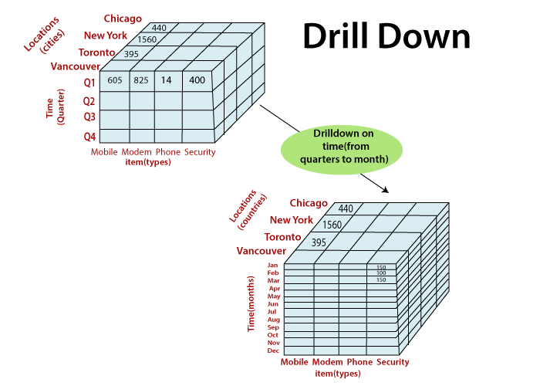

Slide 17
Slice
A slice is a subset of the cubes corresponding to a single value for one or more members of the dimension.
Eg: when the customer wants a selection on one dimension of a three-dimensional cube resulting in a two-dimensional site.
Slice operations perform a selection on one dimension of the given cube, thus resulting in a subcube.

Slide 18
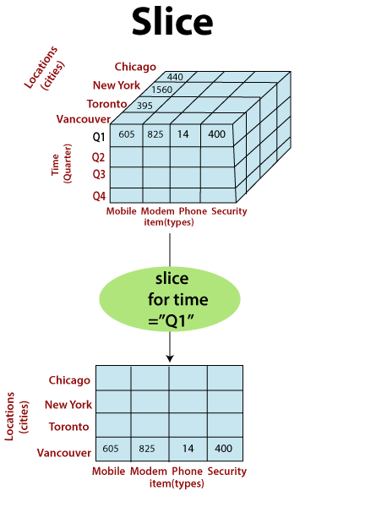
A slice operation where the sales data are selected from the central cube for the dimension time using the criterion time = “Q1.”

Slide 19
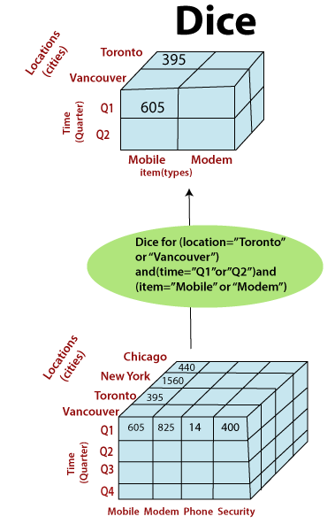
Dice
The dice operation defines a subcube by performing a selection on two or more dimensions.
A dice operation on the central cube based on the following selection criteria that involve three dimensions:
(location = “Toronto” or “Vancouver”) and (time = “Q1” or “Q2”)
and (item = “mobile ” or “modem”.

Slide 20
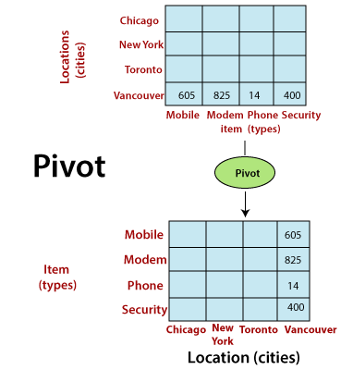
Pivot
The pivot operation is also called a rotation.
Pivot is a visualization operation. .
Rotates the data axes in view to provide an alternative presentation of the data.
May swap the rows and columns or move one of the row-dimensions into the column dimensions.

Slide 21
Other OLAP Operations
Drill-across executes queries involving (i.e., across) more than one fact table.
The drill-through operation uses relational SQL facilities to drill through the bottom level of a data cube down to its back-end relational tables.

Slide 22
Introduction to KDD process
KDD- Knowledge Discovery in Datases
Notes:
In the context of computer science, “Data Mining” can be referred to as knowledge mining from data, knowledge extraction, data/pattern analysis, data archaeology, and data dredging.
Data Mining also known as Knowledge Discovery in Databases, refers to the nontrivial extraction of implicit, previously unknown and potentially useful information from data stored in databases.
The need of data mining is to extract useful information from large datasets and use it to make predictions or better decision-making. Nowadays, data mining is used in almost all places where a large amount of data is stored and processed.
For examples: Banking sector, Market Basket Analysis, Network Intrusion Detection.
Market basket analysis is a data mining technique that analyzes patterns of co-occurrence and determines the strength of the link between products purchased together.

Slide 23
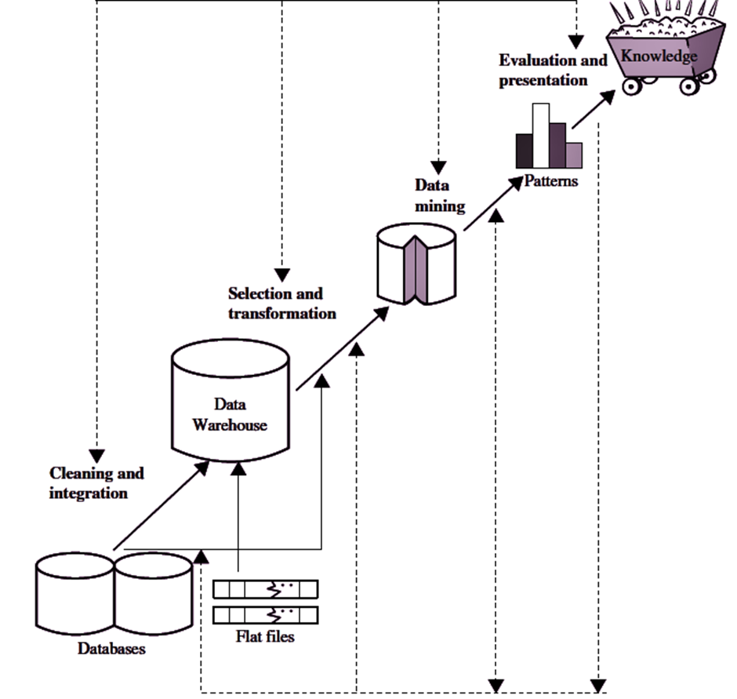
1. Data cleaning (to remove noise and inconsistent data)
2. Data integration (where multiple data sources may be combined)
3. Data selection (where data relevant to the analysis task are retrieved from the database)
4. Data transformation (where data are transformed and consolidated into forms appropriate for mining by performing summary or aggregation operations)
5. Data mining (an essential process where intelligent methods are applied to extract data patterns)
6. Pattern evaluation (to identify the truly interesting patterns representing knowledge based on interestingness measures)
7. Knowledge presentation (where visualization and knowledge representation techniques are used to present mined knowledge to users)
Notes:
KDD (Knowledge Discovery in Databases) is a process that involves the extraction of useful, previously unknown, and potentially valuable information from large datasets.
The KDD process is an iterative process and it requires multiple iterations of the above steps to extract accurate knowledge from the data.
The following steps are included in KDD process:
Data Cleaning
Data cleaning is defined as removal of noisy and irrelevant data from collection.
Cleaning in case of Missing values.
Cleaning noisy data, where noise is a random or variance error.
Cleaning with Data discrepancy detection and Data transformation tools.
Data Integration
Data integration is defined as heterogeneous data from multiple sources combined in a common source(DataWarehouse).
Data integration using Data Migration tools, Data Synchronization tools and ETL(Extract-Transformation-Load) process.
Data Selection
Data selection is defined as the process where data relevant to the analysis is decided and retrieved from the data collection. For this we can use Neural network, Decision Trees, Naive bayes, Clustering, and Regression methods.
Data Transformation
Data Transformation is defined as the process of transforming data into appropriate form required by mining procedure.
Data Transformation is a two step process:
Data Mapping: Assigning elements from source base to destination to capture transformations.
Code generation: Creation of the actual transformation program.
Data Mining
Data mining is defined as techniques that are applied to extract patterns potentially useful.
It transforms task relevant data into patterns, and decides purpose of model using classification or characterization.
Pattern Evaluation
Pattern Evaluation is defined as identifying strictly increasing patterns representing knowledge based on given measures.
It find interestingness score of each pattern, and uses summarization and Visualization to make data understandable by user.
Knowledge Representation
This involves presenting the results in a way that is meaningful and can be used to make decisions.

Slide 24
Advantages of KDD
Improves decision-making
Increased efficiency
Better customer service
Fraud detection
Predictive modeling
Notes:
Advantages of KDD
Improves decision-making: KDD provides valuable insights and knowledge that can help organizations make better decisions.
Increased efficiency: KDD automates repetitive and time-consuming tasks and makes the data ready for analysis, which saves time and money.
Better customer service: KDD helps organizations gain a better understanding of their customers’ needs and preferences, which can help them provide better customer service.
Fraud detection: KDD can be used to detect fraudulent activities by identifying patterns and anomalies in the data that may indicate fraud.
Predictive modeling: KDD can be used to build predictive models that can forecast future trends and patterns.

Slide 25
Disadvantages of KDD
Privacy concerns
Complexity
Unintended consequences
Data Quality
High cost
Overfitting
Notes:
Disadvantages of KDD
Privacy concerns: KDD can raise privacy concerns as it involves collecting and analyzing large amounts of data, which can include sensitive information about individuals.
Complexity: KDD can be a complex process that requires specialized skills and knowledge to implement and interpret the results.
Unintended consequences: KDD can lead to unintended consequences, such as bias or discrimination, if the data or models are not properly understood or used.
Data Quality: KDD process heavily depends on the quality of data, if data is not accurate or consistent, the results can be misleading
High cost: KDD can be an expensive process, requiring significant investments in hardware, software, and personnel.
Overfitting: KDD process can lead to overfitting, which is a common problem in machine learning where a model learns the detail and noise in the training data to the extent that it negatively impacts the performance of the model on new unseen data.

Slide 26
Data Mining

Slide 27
Definition
Data mining is the process of discovering interesting patterns and knowledge from large amounts of data.
The data sources can include databases, data warehouses, the Web, other information repositories, or data that are streamed into the system dynamically.
Key Outcomes of Data Mining
Automatic discovery of patterns
Prediction of likely outcomes
Creation of actionable information
Focus on large datasets and databases

Slide 28
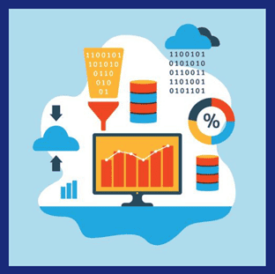
What is Data Mining?
The process of extracting knowledge or insights from large amounts of data using various statistical and computational techniques.
The data can be structured, semi-structured or unstructured.
Data can be stored in various forms such as databases, data warehouses, and data lakes.
Primary goal - to discover hidden patterns and relationships in the data that can be used to make informed decisions or predictions.
How? – By exploring the data using various techniques such as clustering, classification, regression analysis, association rule mining, and anomaly detection.
Applications- marketing, finance, healthcare, and telecommunications.
Eg: in marketing, data mining can be used to identify customer segments and target marketing campaigns, while in healthcare, it can be used to identify risk factors for diseases and develop personalized treatment plans.
Notes:
Data mining is the process of extracting knowledge or insights from large amounts of data using various statistical and computational techniques.
The data can be structured, semi-structured or unstructured, and can be stored in various forms such as databases, data warehouses, and data lakes.
The primary goal of data mining is to discover hidden patterns and relationships in the data that can be used to make informed decisions or predictions. This involves exploring the data using various techniques such as clustering, classification, regression analysis, association rule mining, and anomaly detection.
Data mining has a wide range of applications across various industries, including marketing, finance, healthcare, and telecommunications. For example, in marketing, data mining can be used to identify customer segments and target marketing campaigns, while in healthcare, it can be used to identify risk factors for diseases and develop personalized treatment plans.

Slide 29
Alternative names for Data Mining
1. Knowledge discovery (mining) in databases (KDD)
2. Knowledge extraction
3. Data/pattern analysis
4. Data archaeology
5. Data dredging
6. Information harvesting
7. Business intelligence

Slide 30
Data Mining on what kinds of data?
Flat Files
Relational Databases
Data Warehouse
Transactional Database
Multimedia Database
Spatial Database
Time-series database
WWW
Notes:
https://www.youtube.com/watch?v=pJWyrpeDOfg

Slide 31
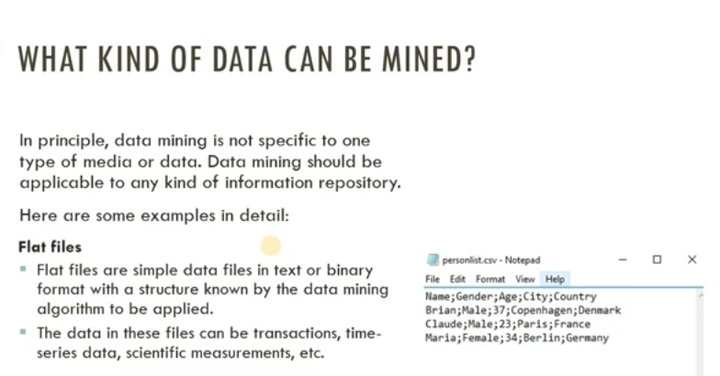

Slide 32
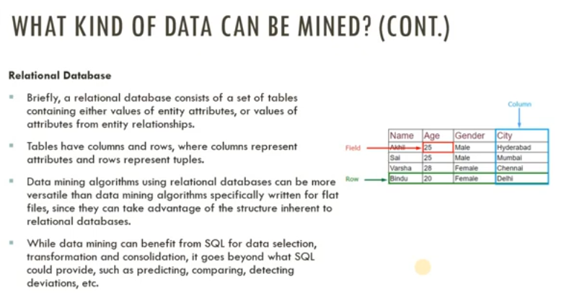

Slide 33
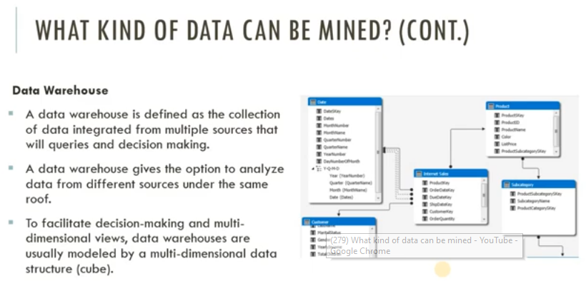

Slide 34
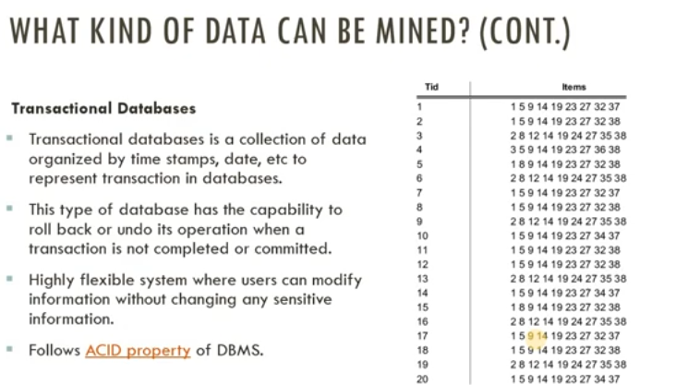
Notes:
Atomicity, Consistency, Isolation and Durability

Slide 35
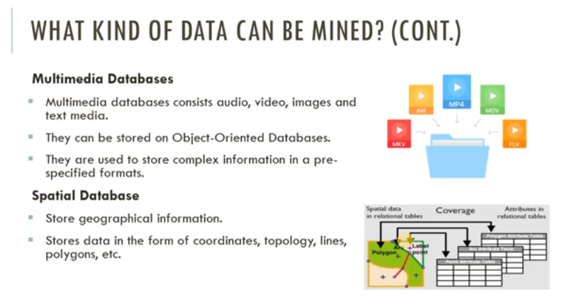

Slide 36
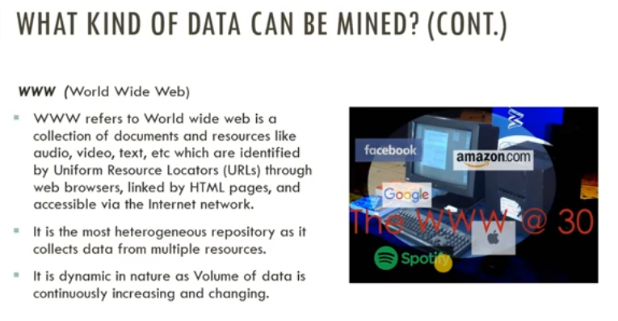

Slide 37
Parameter | KDD | Data Mining
Definition | KDD refers to a process of identifying valid, novel, potentially useful, and ultimately understandable patterns and relationships in data. | Data Mining refers to a process of extracting useful and valuable information or patterns from large data sets.
Objective | To find useful knowledge from data. | To extract useful information from data.
Techniques Used | Data cleaning, data integration, data selection, data transformation, data mining, pattern evaluation, and knowledge representation and visualization. | Association rules, classification, clustering, regression, decision trees, neural networks, and dimensionality reduction.
Output | Structured information, such as rules and models, that can be used to make decisions or predictions. | Patterns, associations, or insights that can be used to improve decision-making or understanding.
Focus | Focus is on the discovery of useful knowledge, rather than simply finding patterns in data. | Data mining focus is on the discovery of patterns or relationships in data.
Role of domain expertise | Domain expertise is important in KDD, as it helps in defining the goals of the process, choosing appropriate data, and interpreting the results. | Domain expertise is less critical in data mining, as the algorithms are designed to identify patterns without relying on prior knowledge.

Slide 38
Data Mining Functionalities
Data mining functionalities specify the kind of patterns to be found in data mining tasks.
In general, data mining tasks can be classified into two categories: descriptive and predictive.
Descriptive mining tasks characterize the general properties of the data in the target data set.
Predictive mining tasks perform inference on the current data in order to make predictions.

Slide 39
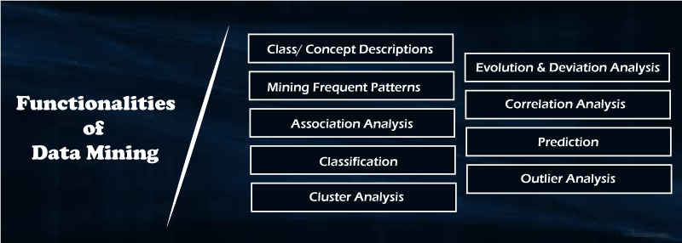

Slide 40
Concept/Class Description
Data can be associated with classes or concepts.
Class : A collection of things sharing a common attribute
Classes of items for sale include computers and printers
Concept: An abstract or general idea inferred or derived from specific instances Concepts of customers include bigSpenders and budgetSpenders.
Summarized, concise and precise descriptions of individual classes and concepts are called class/concept descriptions.
These descriptions can be derived using
(1) data characterization, by summarizing the data of the class under study (often called the target class) in general terms
(2) data discrimination, by comparison of the target class with one or a set of comparative classes (often called the contrasting classes), or
(3) both data characterization and discrimination.

Slide 41
Data characterization
Data characterization is a summarization of the general characteristics or features of a target class of data.
The data corresponding to the user-specified class are typically collected by a query.
For example, to study the characteristics of software products with sales that increased by 10% in the previous year, the data related to such products can be collected by executing an SQL query on the sales database.
Simple data summaries can be done based on statistical measures and plots.
The data cube–based OLAP roll-up operation can be used to perform data summarization along a specified dimension.
An attribute-oriented induction technique can be used to perform data generalization and characterization without step-by-step user interaction

Slide 42
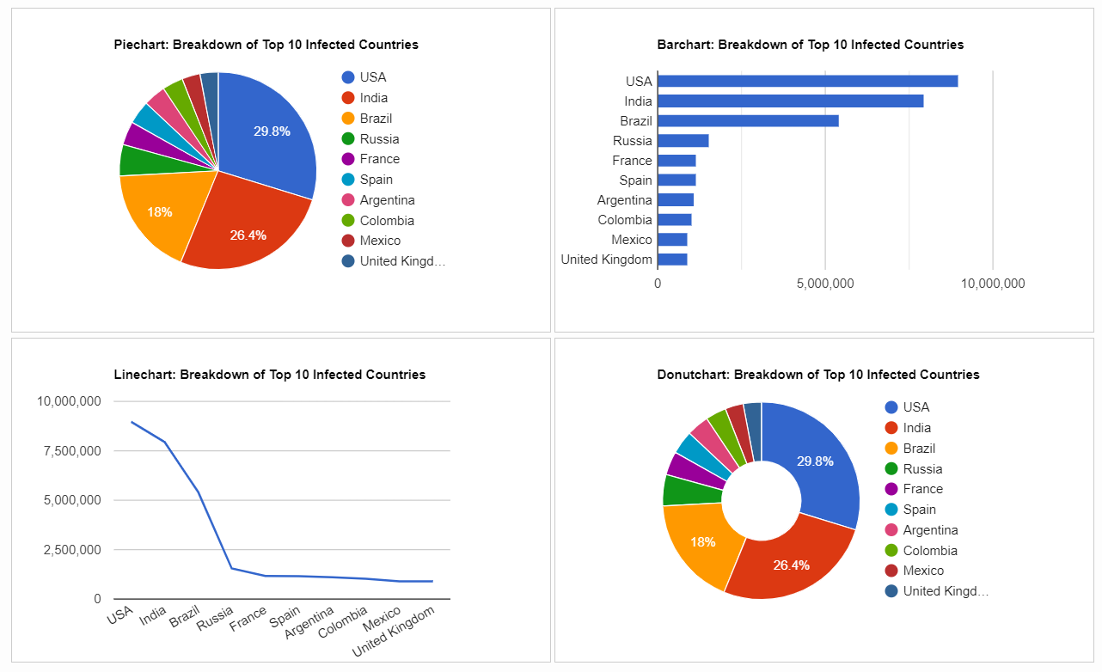
Data characterization
The output of data characterization can be presented in various forms.
Eg: pie charts, bar charts, curves, multidimensional data cubes, and multidimensional tables, including crosstabs.
The resulting descriptions can also be presented as generalized relations or in rule form (called characteristic rules).

Slide 43
Eg: Data characterization
A customer relationship manager at AllElectronics may order the following data mining task:
“Summarize the characteristics of customers who spend more than $5000 a year at AllElectronics.”
The result is a general profile of these customers, such as that they are 40 to 50 years old, employed, and have excellent credit ratings.
The data mining system should allow the customer relationship manager to drill down on any dimension, such as on occupation to view these customers according to their type of employment.

Slide 44
Data discrimination
Data discrimination is a comparison of the general features of the target class data objects against the general features of objects from one or multiple contrasting classes.
The target and contrasting classes can be specified by a user, and the corresponding data objects can be retrieved through database queries.
For example, a user may want to compare the general features of software products with sales that increased by 10% last year against those with sales that decreased by at least 30% during the same period.
The methods used for data discrimination are similar to those used for data characterization.

Slide 45
Data discrimination
The forms of output presentation are similar to those for characteristic descriptions, although discrimination descriptions should include comparative measures that help to distinguish between the target and contrasting classes.
Discrimination descriptions expressed in the form of rules are referred to as discriminant rules.

Slide 46
Eg:Data discrimination
A customer relationship manager at AllElectronics may want to compare two groups of customers—those who shop for computer products regularly (e.g., more than twice a month) and those who rarely shop for such products (e.g., less than three times a year).
The resulting description provides a general comparative profile of these customers, such as that
80% of the customers who frequently purchase computer products are between 20 and 40 years old and have a university education,
whereas 60% of the customers who infrequently buy such products are either seniors or youths, and have no university degree.
Drilling down on a dimension like occupation,or adding a new dimension like income level, may help to find even more discriminative features between the two classes.

Slide 47
Mining Frequent Patterns
Frequent patterns are patterns that occur frequently in data.
Frequent itemset - refers to a set of items that often appear together in a transactional data set;
Eg: milk and bread, which are frequently bought together in grocery stores by many customers.
Sequential pattern A frequently occurring subsequence.
Eg:customers, tend to purchase first a laptop, followed by a digital camera, and then a memory card
Frequent substructure refer to different structural forms (e.g., graphs, trees, or lattices) that may be combined with itemsets or subsequences. If a substructure occurs frequently, it is called a (frequent) structured pattern.
Mining frequent patterns leads to the discovery of interesting associations and correlations within data.
Frequent itemset mining is a fundamental form of frequent pattern mining.

Slide 48
Association analysis.
Suppose that, as a marketing manager at AllElectronics, you want to know which items are frequently purchased together (i.e., within the same transaction).
An example of such a rule, mined from the AllElectronics transactional database, is:
where X is a variable representing a customer.
A confidence, or certainty, of 50% means that if a customer buys a computer, there is a 50% chance that she will buy software as well.
A 1% support means that 1% of all the transactions under analysis show that computer and software are purchased together.

Slide 49
Association analysis.
The association rule involves a single attribute or predicate (i.e., buys) that repeats.
Association rules that contain a single predicate are referred to as single-dimensional association rules.
Dropping the predicate notation, the rule can be written simply as

Slide 50

Example: Multi dimensional Association rules
AllElectronics relational database related to purchases, a data mining system may find association rules like

Slide 51
Example: Multi dimensional Association rules
Of the AllElectronics customers under study
2% are 20 to 29 years old with an income of $40,000 to $49,000 and have purchased a laptop (computer) at AllElectronics.
There is a 60% probability that a customer in this age and income group will purchase a laptop.
An association involving more than one attribute or predicate (i.e., age, income, and buys).
Each attribute is referred to as a dimension-> referred to as a multidimensional association rule.

Slide 52
Classification and Regression for Predictive Analysis
Classification
Classification is the process of finding a model (or function) that describes and distinguishes data classes or concepts.
The model are derived based on the analysis of a set of training data (i.e., data objects for which the class labels are known).
The model is used to predict the class label of objects for which the the class label is unknown.
How is the derived model presented?
classification rules (i.e., IF-THEN rules)
Decision trees
Mathematical formulae
neural networks

Slide 53
Decision tree
A flowchart-like tree structure
Each node denotes a test on an attribute value
Each branch represents an outcome of the test
Tree leaves represent classes or class distributions.
Decision trees can easily be converted to classification rules.
Neural network
used for classification
A collection of neuron-like processing units with weighted connections between the units.
Other Classification Models:
Naïve Bayesian classification
Support Vector Machines
k-nearest-neighbor classification.

Slide 54
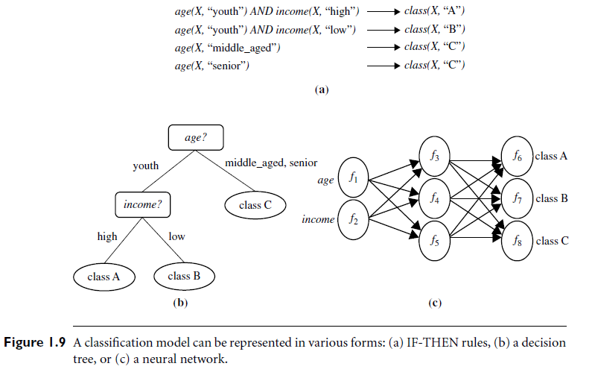

Slide 55
Regression
Regression models continuous-valued functions.
Used to predict missing or unavailable numerical data values rather than (discrete) class labels.
Prediction -> both numeric prediction and class label prediction.
Regression analysis - a statistical methodology that is most often used for numeric prediction.
Regression also encompasses the identification of distribution trends based on the available data.

Slide 56
Classification and Regression for Predictive Analysis
Relevance analysis
Classification and regression may need to be preceded by relevance analysis.
Attempts to identify attributes that are significantly relevant to the classification and regression process.
Other attributes, which are irrelevant, can then be excluded from consideration.

Slide 57
Eg: Classification
Suppose as a sales manager of AllElectronics you want to classify a large set of items in the store, based on three kinds of responses to a sales campaign:good response, mild response and no response.
Derive a model for each of these three classes based on the descriptive features of the items, such as price, brand, place made, type, and category.
The resulting classification should maximally distinguish each class from the others, presenting an organized picture of the data set.

Slide 58
Eg: Regression
Predict the amount of revenue that each item will generate during an upcoming sale at AllElectronics, based on the previous sales data.
An example of regression analysis because the regression model constructed will predict a continuous function (or ordered value.)

Slide 59
Cluster Analysis
Clustering analyzes data objects without consulting class labels.
Clustering can be used to generate class labels for a group of data.
The objects are clustered or grouped based on the principle of maximizing the intraclass similarity and minimizing the interclass similarity.
Objects within a cluster have high similarity in comparison to one another, but are rather dissimilar to objects in other clusters.
Each cluster so formed can be viewed as a class of objects, from which rules can be derived.
Clustering facilitate taxonomy formation -> the organization of observations into a hierarchy of classes that group similar events together.

Slide 60
Example
Cluster analysis can be performed on AllElectronics customer data to identify homogeneous subpopulations of customers.
These clusters may represent individual target groups for marketing.
Three clusters of data points are evident.

Slide 62
Outlier Analysis
A data set may contain objects that do not comply with the general behavior or model of the data- Outliers.
Many data mining methods discard outliers as noise or exceptions.
In some applications the rare events can be more interesting than the more regularly occurring ones.
The analysis of outlier data is referred to as outlier analysis or anomaly mining.
Detected using:
statistical tests that assume a distribution or probability model for the data
distance measures where objects that are remote from any other cluster are considered outliers.
Density-based methods may identify outliers in a local region, although they look normal from a global statistical distribution view.
Notes:
Eg: Fraud detection

Slide 63
Example -Outlier analysis
Outlier analysis may uncover fraudulent usage of credit cards by detecting purchases of unusually large amounts for a given account number in comparison to regular charges incurred by the same account.
Outlier values may also be detected with respect to the locations and types of purchase, or the purchase frequency.

Slide 64
Are All Patterns Interesting?
No—only a small fraction of the patterns potentially generated would actually be of interest to a given user.
“What makes a pattern interesting?
Can a data mining system generate all of the interesting patterns?
Can the system generate only the interesting ones?”

Slide 65
“What makes a pattern interesting?
A pattern is interesting if it is
(1) easily understood by humans
(2) valid on new or test data with some degree of certainty
(3) potentially useful
(4) novel.
A pattern is also interesting if it validates a hypothesis that the user sought to confirm.
An interesting pattern represents knowledge.

Slide 66

Objective measures of pattern interestingness
Based on the structure of discovered patterns and the statistics underlying them.
An objective measure for association rules of the form X =>Y is rule Support,
Represent the percentage of transactions from a transaction database that the given rule satisfies.
This is taken to be the probability P(X U Y), where X U Y indicates that a transaction contains both X and Y, that is, the union of itemsets X and Y.
Confidence, which assesses the degree of certainty of the detected association.
This is taken to be the conditional probability P(Y|X), that is, the probability that a transaction containing X also contains Y.
More formally, support and confidence are defined as

Slide 67
Objective measures of pattern interestingness
Accuracy -the percentage of data that are correctly classified by a rule.
Coverage is similar to support- the percentage of data to which a rule applies.
Although objective measures help identify interesting patterns, they are often insufficient unless combined with subjective measures that reflect a particular user’s needs and interests.
For example, patterns describing the characteristics of customers who shop frequently at AllElectronics should be interesting to the marketing manager, but may be of little interest to other analysts studying the same database for patterns on employee performance.
Many patterns that are interesting by objective standards may represent common sense and, therefore, are actually uninteresting.

Slide 68
Subjective interestingness measures
Based on user beliefs in the data.
These measures find patterns interesting if the patterns are unexpected (contradicting a user’s belief) or offer strategic information on which the user can act(actionable patterns).
For example, patterns like “a large earthquake often follows a cluster of small quakes” may be highly actionable if users can act on the information to save lives.
Patterns that are expected can be interesting if they confirm a hypothesis that the user wishes to validate or they resemble a user’s hunch.
Eg: During a clinical trial for a new medication, researchers might expect the medication group to show improvement in certain symptoms compared to the placebo group. Observing this expected pattern strengthens the evidence for the medication's effectiveness.
Notes:
During a clinical trial for a new medication, researchers might expect the medication group to show improvement in certain symptoms compared to the placebo group. Observing this expected pattern strengthens the evidence for the medication's effectiveness.

Slide 69
Can a data mining system generate all of the interesting patterns?
Refers to the completeness of a data mining algorithm.
It is often unrealistic and inefficient for data mining systems to generate all possible patterns.
Instead, user provided constraints and interestingness measures should be used to focus the search.
For some mining tasks, such as association, this is often sufficient to ensure the completeness of the algorithm.
Association rule mining is an example where the use of constraints and interestingness measures can ensure the completeness of mining.

Slide 70
Can a data mining system generate only interesting patterns?
An optimization problem in data mining.
It is highly desirable for data mining systems to generate only interesting patterns.
Users and data mining systems would have to search through the patterns generated to identify the truly interesting ones.
Progress made but optimization remains a challenging issue in data mining.
Measures of pattern interestingness are essential for the efficient discovery of patterns by target users.
Such measures can be used after the data mining step to rank the discovered patterns according to their interestingness, filtering out the uninteresting ones.
Can be used to guide and constrain the discovery process, improving the search efficiency by pruning away subsets of the pattern space that do not satisfy pre-specified interestingness constraints.

Slide 71
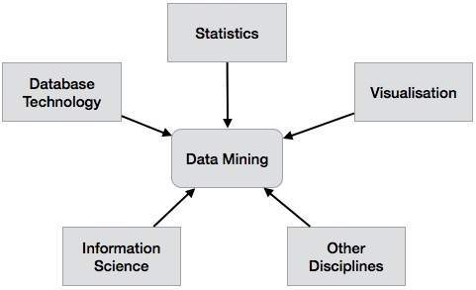
Data Mining System Classification
A data mining system can be classified according to the following criteria −
Database Technology
Statistics
Machine Learning
Information Science
Visualization
Other Disciplines
Apart from these, a data mining system can also be classified based on the kind of
(a) databases mined
(b) knowledge mined
(c) techniques utilized
(d) applications adapted

Slide 72
Classification Based on the Databases Mined
We can classify a data mining system according to the kind of databases mined.
Database system can be classified according to different criteria such as data models, types of data, etc.
The data mining system can be classified accordingly.
For example, if we classify a database according to the data model, then we may have a relational, transactional, object-relational, or data warehouse mining system.

Slide 73
Classification Based on the kind of Knowledge Mined
We can classify a data mining system according to the kind of knowledge mined.
Data mining system is classified on the basis of functionalities such as −
Characterization
Discrimination
Association and Correlation Analysis
Classification
Prediction
Outlier Analysis
Evolution Analysis

Slide 74
Classification Based on the Techniques Utilized
We can classify a data mining system according to the kind of techniques used.
We can describe these techniques according to the degree of user interaction involved or the methods of analysis employed.
Machine learning, visualization, pattern recognition, neural networks, database-oriented or data-warehouse oriented techniques.
Classification by User Interaction:
Supervised Learning: Decision Trees, Support Vector Machines (SVMs)
Unsupervised Learning: Clustering, Association Rule Learning
Classification by Analysis Methods:
Statistical Techniques: Linear Regression, Logistic Regression
Machine Learning Techniques: Artificial Neural Networks (ANNs), Random Forests

Slide 75
Classification Based on the Applications Adapted
We can classify a data mining system according to the applications adapted.
Eg:
Finance
Telecommunications
DNA
Stock Markets
E-mail

